Slide 1


Mastering Excel Formulas

Slide 2
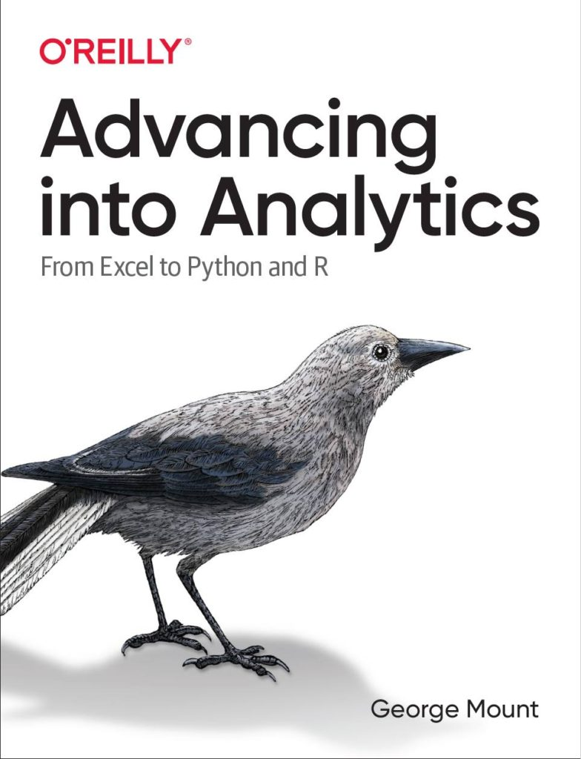


Hi, I’m George

Slide 3

Objectives for this session
Comfortably use formulas like SUMIFS and XLOOKUP
Design and audit complex, nested formulas
Look up data in an instant

Slide 4
Sections
Basics of formulas and functions
Formula design & audit
Conditional logic & formulas
Dynamic arrays
LET(), LAMBDA() and the future of Excel

Slide 5
Following along
Each section is a workbook
Solutions in separate workbooks
Follow along with demo notes

Slide 6
1. Basics of formulas and functions

Slide 7
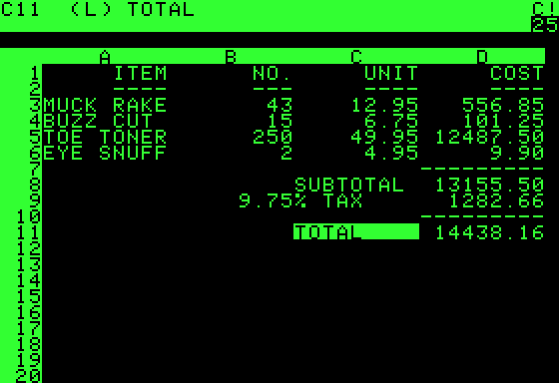
What is a formula?
User-designed equation
Usually starts with = (but doesn’t have to!)
https://en.wikipedia.org/wiki/VisiCalc
Notes:
Demonstrate in Excel how this works
Visi”Calc”

Slide 8
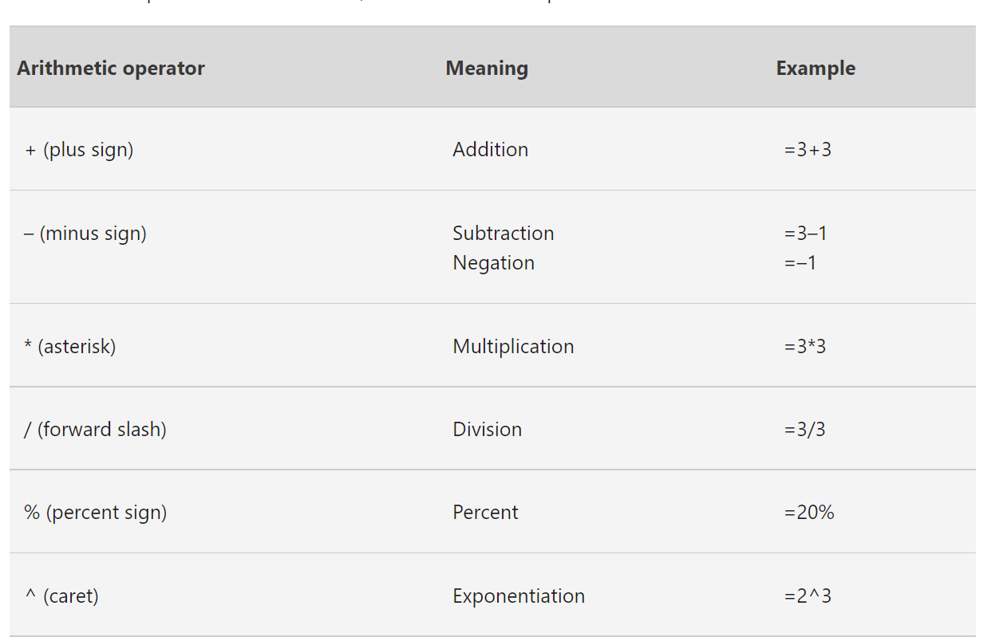
Numeric formulas
Follows the order of operations
https://support.microsoft.com/en-us/office/calculation-operators-and-precedence-in-excel-48be406d-4975-4d31-b2b8-7af9e0e2878a
Notes:
Demonstrate in Excel how this works
Visi”Calc”

Slide 9
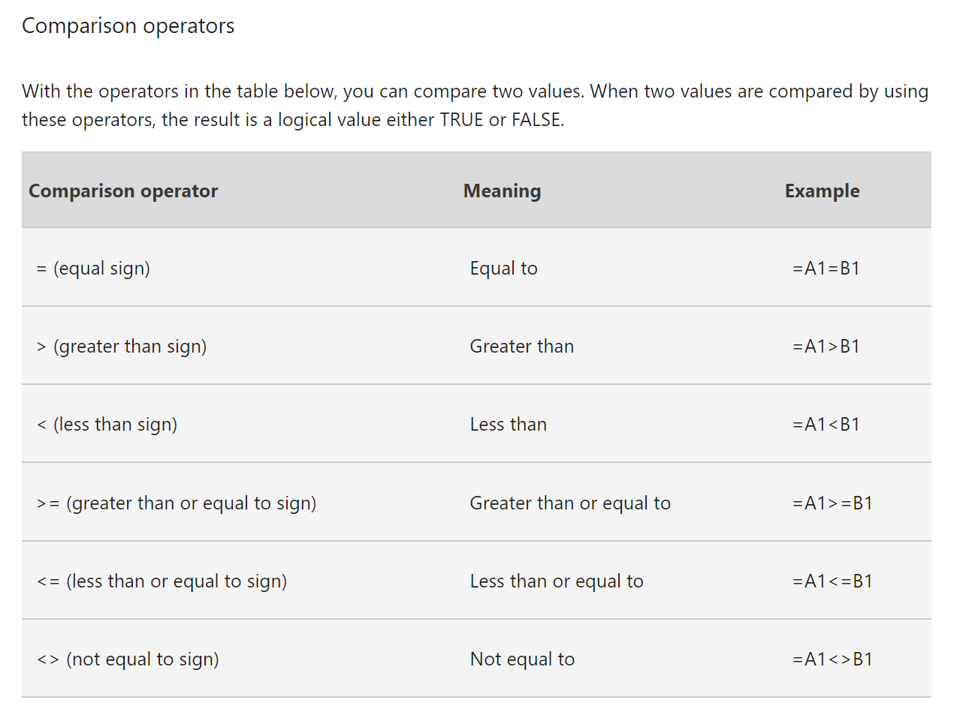
Comparison formulas
Useful for error-checking
https://support.microsoft.com/en-us/office/calculation-operators-and-precedence-in-excel-48be406d-4975-4d31-b2b8-7af9e0e2878a
Notes:
Demonstrate in Excel how this works
Visi”Calc”

Slide 10
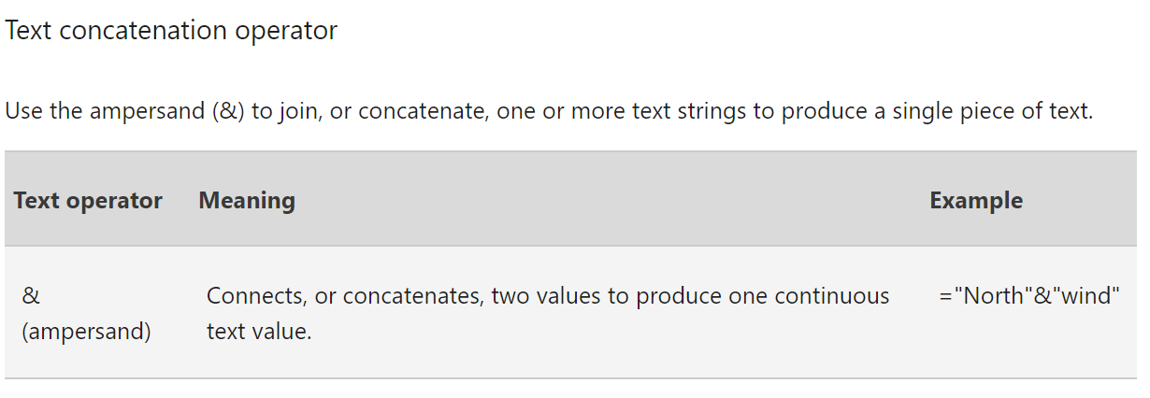
Text formulas
Small but mighty!
https://support.microsoft.com/en-us/office/calculation-operators-and-precedence-in-excel-48be406d-4975-4d31-b2b8-7af9e0e2878a
Notes:
Show how this works

Slide 11
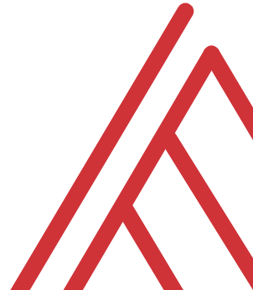
Questions?

Slide 12
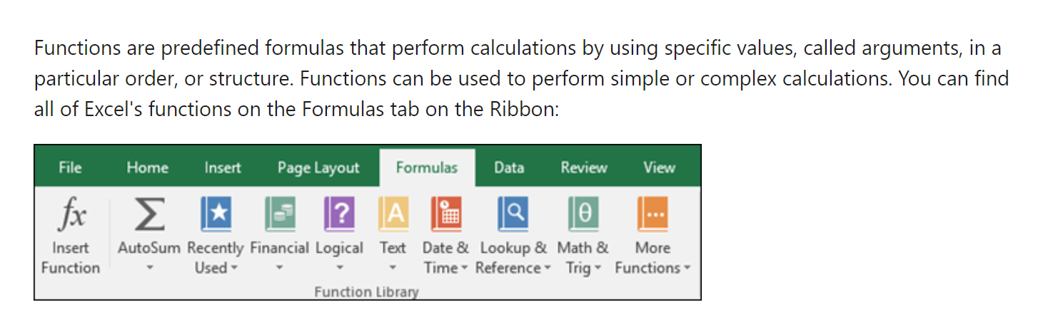
What is a function?
https://support.microsoft.com/en-us/office/using-functions-and-nested-functions-in-excel-formulas-3f4cf298-ded7-4f91-bc80-607533b65f02#:~:text=Functions%20are%20predefined%20formulas%20that,Excel%20function%20syntax
Notes:
Ask learner to name a few functions in the chat

Slide 13
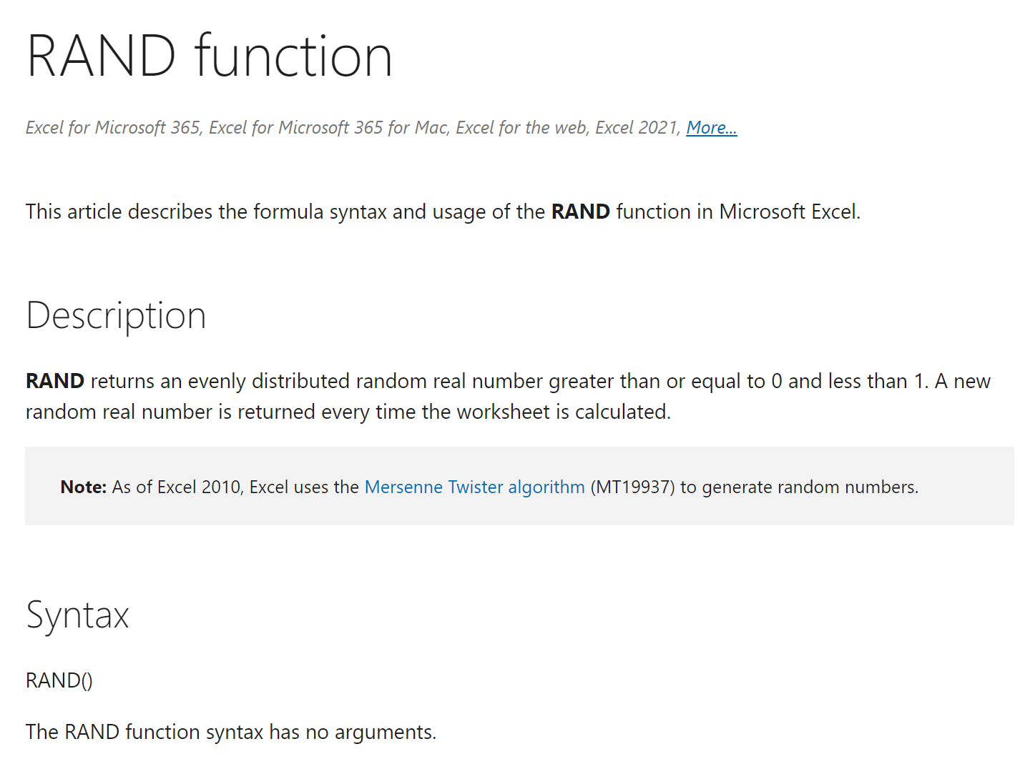
Not all functions are defined equal…
Some have no arguments
https://support.microsoft.com/en-us/office/rand-function-4cbfa695-8869-4788-8d90-021ea9f5be73
Notes:
Ask learner to name a few functions in the chat

Slide 14
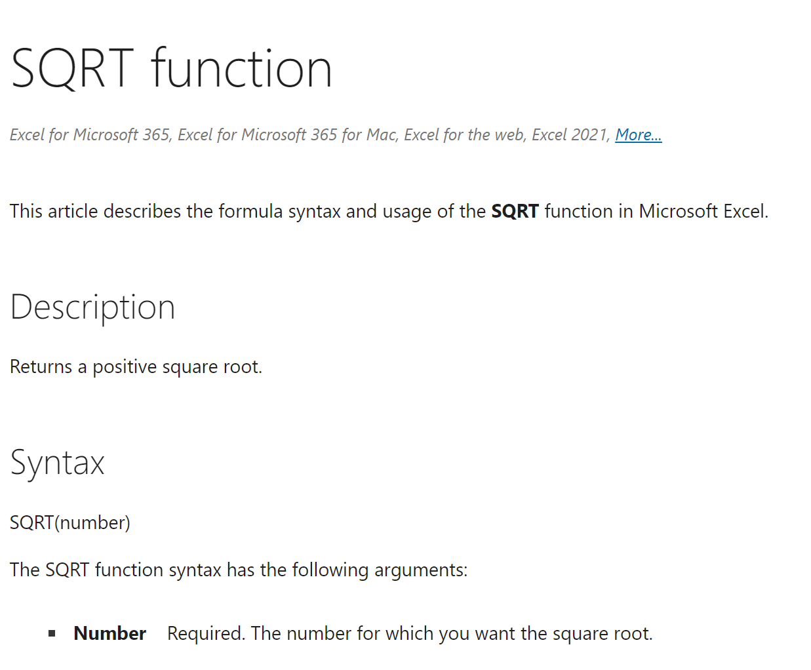
Not all functions are defined equal…
Some always have the same number
https://support.microsoft.com/en-us/office/sqrt-function-654975c2-05c4-4831-9a24-2c65e4040fdf
Notes:
Ask learner to name a few functions in the chat

Slide 15
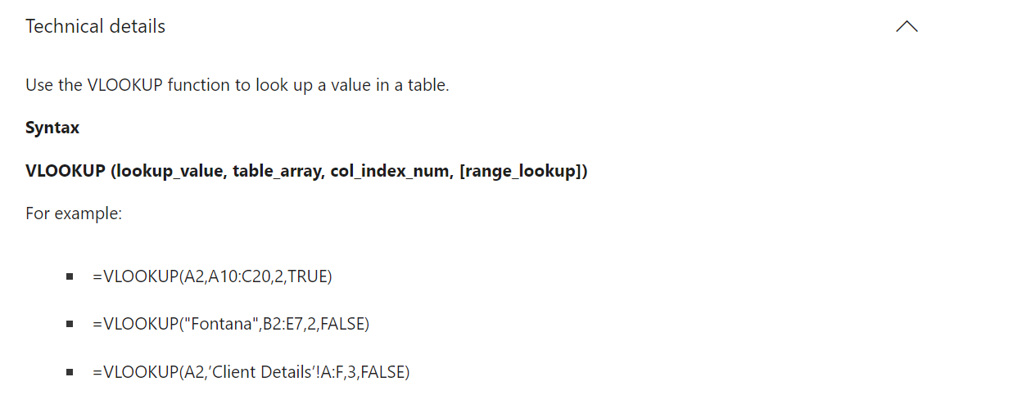
Not all functions are defined equal…
Some have optional and default arguments
https://support.microsoft.com/en-us/office/vlookup-function-0bbc8083-26fe-4963-8ab8-93a18ad188a1
Notes:
Ask learner to name a few functions in the chat

Slide 16
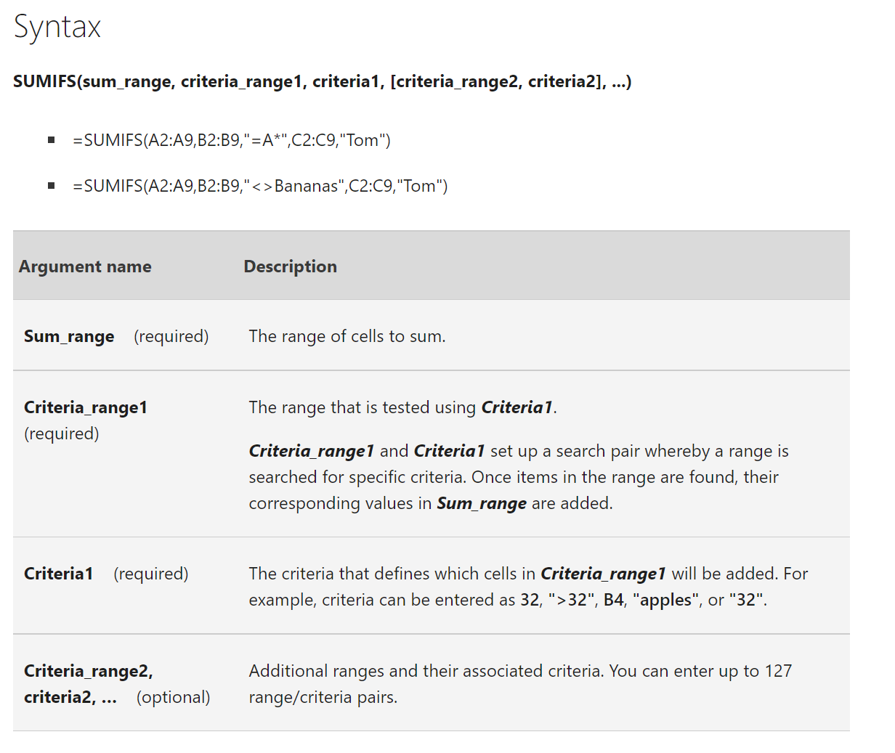
Not all functions are defined equal…
Some have an infinite number (which can be optional!)
https://support.microsoft.com/en-us/office/sumifs-function-c9e748f5-7ea7-455d-9406-611cebce642b
Notes:
Ask learner to name a few functions in the chat

Slide 17
Exercises
T/F: Every Excel formula/function must begin with an = sign.
Are the following formulas or functions:
ABS(-10)
B4<B3
SQRT(10*2)
What is the A4 in the following function called?
FORMULATEXT(A4)

Slide 18
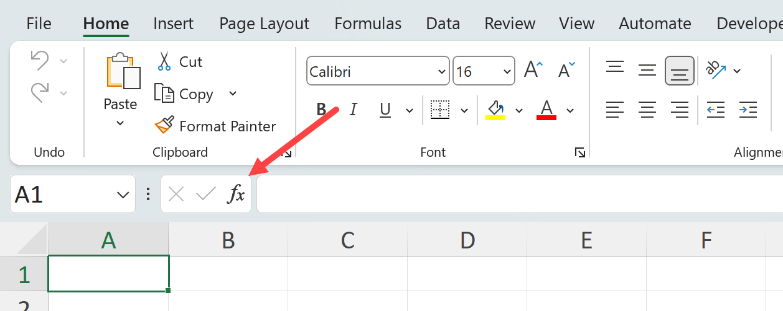
Demo
Worksheet: count-v-counta
Using the Insert Function menu:
Find the results of COUNT() vs COUNTA() for cells A1-A6

Slide 19
Exercise
Learn & teach a new function!
Peruse the Insert Function menu to find an unfamiliar function
Test, evaluate & demonstrate it to class
There are over 450 functions in Excel

Slide 20
Questions?

Slide 21
2. Named ranges and tables

Slide 22

How can we avoid this?
Notes:
Ask learner to name a few functions in the chat

Slide 23
Demo
Worksheet: references
Relative vs absolute references
Creating named ranges

Slide 24
Exercise
Worksheet: ranges-practice
Name the range
Find the average ______
Delete the range?

Slide 25
Questions?

Slide 26
8 reasons to LOVE Excel tables

Slide 27
Demo
Worksheet: count-v-counta
Why use (and love) Excel tables?

Slide 28
3. Conditional logic & formulas

Slide 29
IF() statements can only go 2 ways…
Does this condition hold up?
Yes: TRUE
No: FALSE
Notes:
Ask learner to name a few functions in the chat

Slide 30
Demo
Worksheet: movie-scores
Which movies meet various criteria?

Slide 31
Avoiding nested IF()s with IFS()
Slice and dice
Drill down/roll up
Pivot/Unpivot
Notes:
Don’t worry too much about the building blocks right now – I have this in here to gauge everyone’s interest

Slide 32
4. Dynamic arrays

Slide 33
5. LET(), LAMBDA() and the future of Excel

Slide 34
4. Formula design & audit

Slide 35
How can we build more readable functions?

Slide 36
Demo
Worksheet: readable
Add white space
Do not repeat yourself
Ditch nested IF()s
Don’t fear the helper column
No hard codes

Slide 37
How can we audit formulas?

Slide 38
Demo
Worksheet: audit
Ctrl + `
FORMULATEXT()
Trace Dependents
F9 & calculation options

Slide 39

Every PivotTable operation is one of these…
Slice and dice
Drill down/roll up
Pivot/Unpivot
Notes:
Don’t worry too much about the building blocks right now – I have this in here to gauge everyone’s interest

Slide 40
Demo
Using the tips worksheet:
Get the total bill by day, then time
Get the total bill for smokers only on Saturday and Sunday
Get average tips by day for each group size
Notes:
This would be rolling up and drilling down
This is slicing and dicing
This is unpivoting and pivoting

Slide 41
Demo
Using wholesale-customers worksheet:
Get the total sum of sales by Region, then Channel
Notes:
Doesn’t work so well, right?

Slide 42
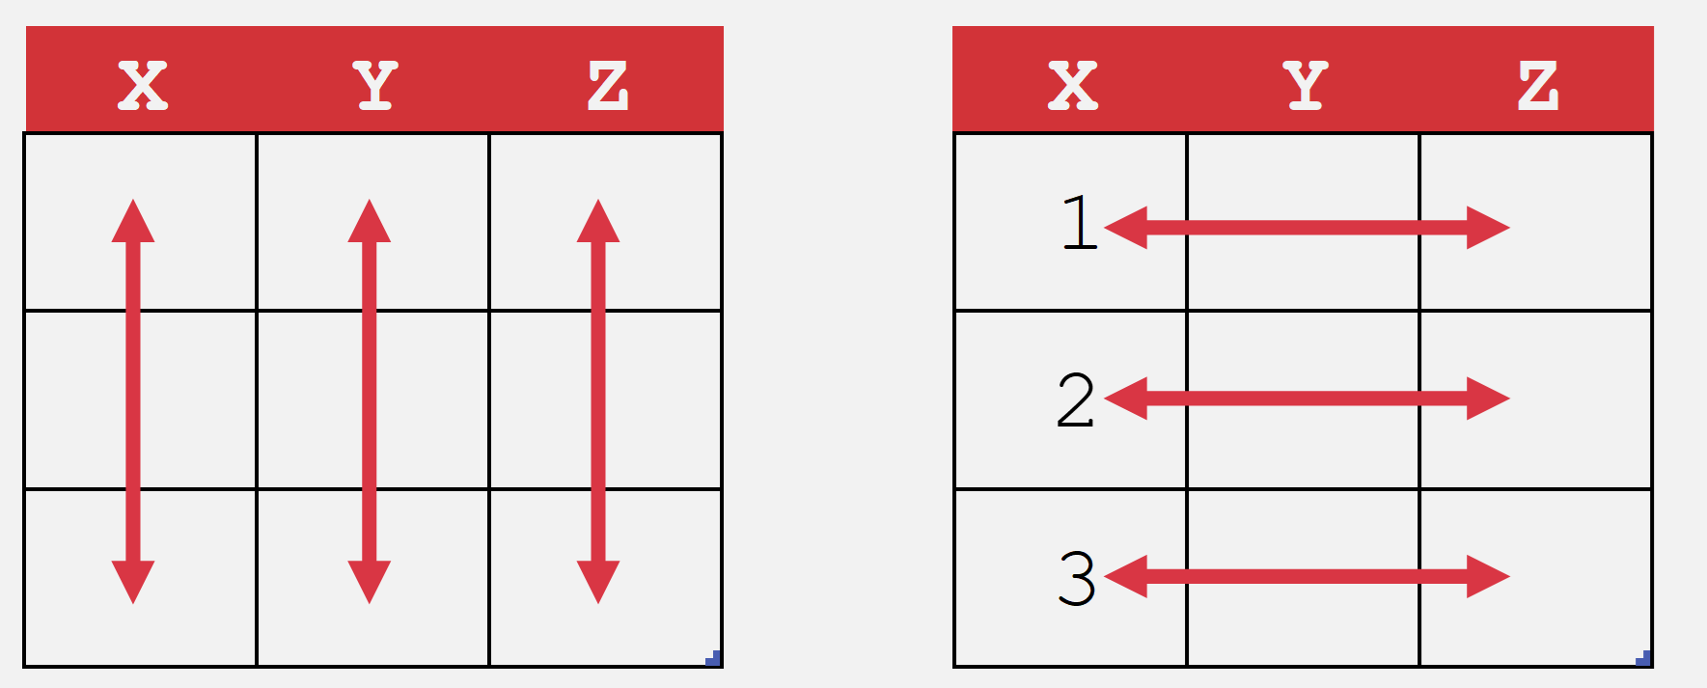
What makes data “Pivot”-ready?
Each variable is in its own column
Each observation is in its own row
Every cell is an observation-variable intersection
Notes:
The Power Query course will be good to actually shape this data. /

Slide 43
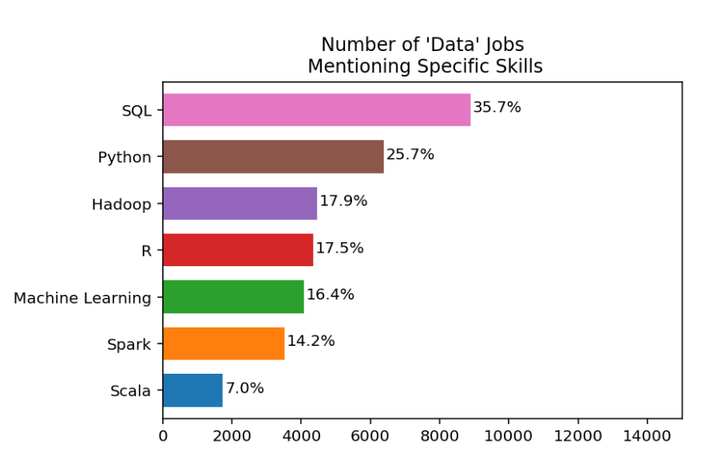
I’m guessing you want work
https://www.dataquest.io/blog/why-sql-is-the-most-important-language-to-learn/

Slide 44

Cross-train your data brain

Slide 45
What is a spreadsheet and when would you use it?
Good for…
Browsing data
Entering/editing data
Flexible data structuring
Quick, visual data analysis on small datasets
Not so much at…
Archiving data
Big data
Interfacing data
Structured data across multiple datasets

Slide 46






Relational databases
1970s origins…
Still with us today!

Slide 47

Meet your librarian
Structured
Query
Language

Slide 48

Are you ready for some baseball?
Lahman database: complete player statistics since 1871 plus salaries, Hall of Fame inductions and more!
Download here for SQLite

Slide 49

Onward to SQLite!
+

Slide 50
ARE YOU READY FOR SOME DRILLS?
How many columns are in Managers?
How many of these columns are of type INTEGER?
How many rows does Managers have?

Slide 51
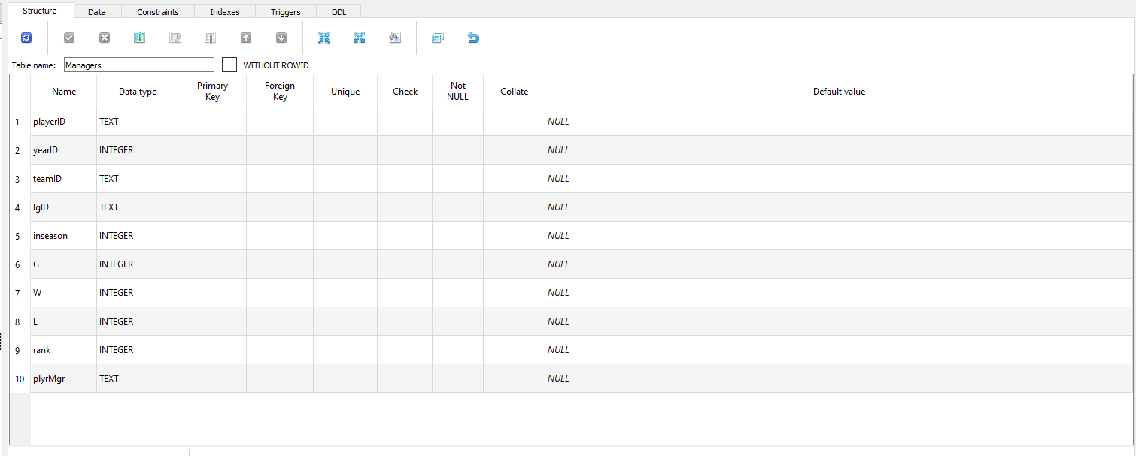
How many columns are in Managers?

Slide 52
2. How many of these columns are of type INTEGER?

Slide 53
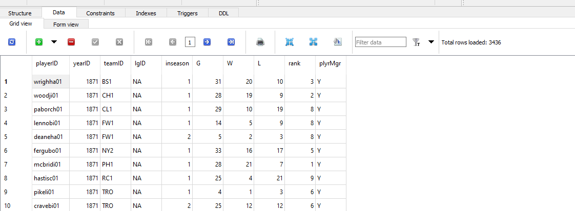
3. How many rows does Managers have?

Slide 54
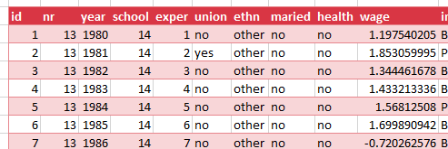
Look to the table
Field/column/attribute
Row/tuple
Value
Table

Slide 55
Questions?

Slide 56
From Excel tables to SQL SELECT

Slide 57
From Excel-ese to SQL-ese
Excel
Data
Calculations
Notes
SQL
Tables
Queries/Scripts
Comments

Slide 58
The grammar of SQL
Term | What it does | Example
Identifier | Identifies an object (i.e. table, field) | Master
Operator | Takes some action (perform calculation,, rename something) | +, AS
Expression | Applies criteria to data | birthYear > 1960

Slide 59

Stylin’ in SQL
0. Good comments starting with –
Each clause on its own line
All operators uppercase (SELECT, ORDER BY, etc.)
Statements end with semicolon (;)

Slide 60
Let’s get coding…
-- List all the tables in our database
SELECT name
FROM sqlite_master
WHERE type='table'
ORDER BY name;
--Get the name and data type from every field in the
--"master" table
PRAGMA table_info(master);

Slide 61
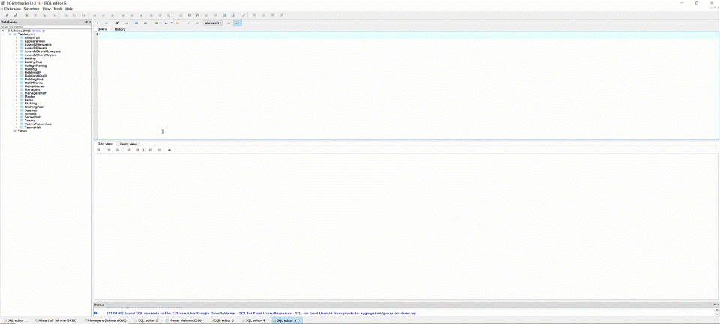
The font is too dang small!

Slide 62
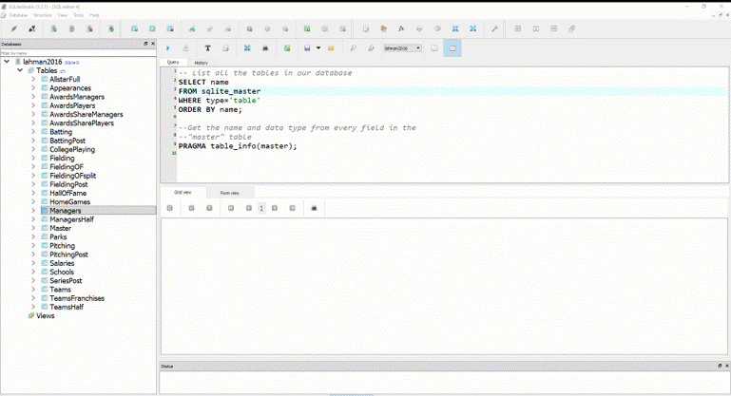
Saving your first .sql script

Slide 63
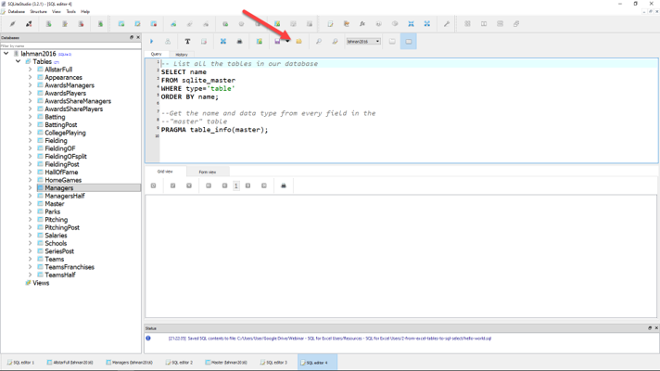
Loading your first .sql script

Slide 64
Demo: sql-tables-example.xlsx

Slide 65
The SQL reader’s digest
Term | What it does
SELECT | Which fields to look for
FROM | Where to look for those fields
WHERE | What criteria those records should meet
GROUP BY | How to aggregate the results
HAVING | What criteria the aggregated results should meet
ORDER BY | How to sort the results
LIMIT | How many records to limit results to

Slide 66
Demo: sql-select-demo.sql

Slide 67
Drills
Using the Teams table:
Select all fields.
Select all fields, first 100 rows.
Select yearID, teamID, W, L.
Select yearID, teamID, and a calculated field win_diff as the difference between W and L.
Create a field team_record such that the first record will read: 1871 Boston Red Stockings: 20-10.

Slide 68
Drills
Using the Teams table:
Select all fields.
Select all fields, first 100 rows.
Select yearID, teamID, W, L.
Select yearID, teamID, and a calculated field win_diff as the difference between W and L.
Create a field team_record such that the first record will read: 1871 Boston Red Stockings: 20-10.
Solutions: sql-select-drills.sql

Slide 69
From Sort & Filter to WHERE and ORDER BY

Slide 70
Demo: sort-filter.xlsx

Slide 71
The SQL reader’s digest
Term | What it does
SELECT | Which fields to look for
FROM | Where to look for those fields
WHERE | What criteria those records should meet
GROUP BY | How to aggregate the results
HAVING | What criteria the aggregated results should meet
ORDER BY | How to sort the results
LIMIT | How many records to limit results to

Slide 72
WHERE: Comparison operators
Operator | Description
= | Equal to
<>, != | Not equal to
> | Greater than
< | Less than
>= | Greater than or equal to
<= | Less than or equal to

Slide 73
WHERE: Logical operators
Operator | Description
BETWEEN | Between an inclusive range
IS NULL | Is a null value
IN | Specifies a range of conditions
OR | Avoids evaluating second condition if first is met
AND | Can be used with other operators
NOT | Excludes results

Slide 74
WHERE LIKE: Wildcard operators
Operator | Description
‘a%’, ‘abc%’ | Returns records that start with a, abc
‘_ _ a’,’_ _ c’ | Returns records with a in 2nd position, abc in 3rd position

Slide 75

A note on NULLs
DOES
Indicate a missing value
DOES NOT
Indicate a value of 0
Indicate why it’s missing

Slide 76
Demo: sort-filter-demo.sql

Slide 77
Drills (continues on next slide)
Using the Managers table:
Select all records, sorted newest to oldest, then by playerID alphabetically.
Select all records between the 1991 and 2000 seasons, sorted high to low by number of games, G.
Create a field, win_diff, calculated as W – L. Return the records with the 25 highest values of win_diff.
How many missing values are in the rank field?

Slide 78
Drills (continued from previous slide)
Using the Managers table:
Select all records, sorted newest to oldest, then by playerID alphabetically.
Select all records between the 1991 and 2000 seasons, sorted high to low by number of games, G.
Create a field, win_diff, calculated as W – L. Return the records with the 25 highest values of win_diff.
How many missing values are in the rank field?

Slide 79
From SUM() and SUMIF() to Aggregation

Slide 80
Demo: aggregation-demo.xlsx

Slide 81
Basic arithmetic functions
Operator | Description
SUM() | Total of records
AVG() | Average of records
MIN() | Minimum value of records
MAX() | Maximum value of records
COUNT() | Count of non-null records

Slide 82
Basic string functions
Operator | Description
CONCAT() | Concatenates fields together
LEFT() | Returns left X values from a string
RIGHT() | Returns right X values from a string
UPPER() | Returns capitalized string
LOWER() | Returns lowercased string

Slide 83
Exploring fields and records
Operator | Description
COUNT(X) | Counts all non-null records of X
DISTINCT X | Returns all distinct values of X
COUNT(DISTINCT X) | Counts distinct values of X

Slide 84
Demo: aggregation-demo.sql

Slide 85
Drills (continues on next slide)
Using the Teams table:
Select the maximum and minimum number of runs.
Select the total number of home runs between 2000 and 2010: total_homers.
Count the number of records where the games played is NULL.
Count the number of records with a recorded attendance.
Return a list of all years reflected in the table.
Count the number of unique franchises since 1915.

Slide 86
Drills (continues on next slide)
Using the Teams table:
Select the maximum and minimum number of runs.
Select the total number of home runs between 2000 and 2010: total_homers.
Count the number of records where the games played is NULL.
Count the number of records with a recorded attendance.
Return a list of all years reflected in the table.
Count the number of unique franchises since 1915.
Solutions: aggregation-drills.sql

Slide 87
From PivotTables to GROUP BY

Slide 88
Demo: group-by-demo.xlsx

Slide 89
The SQL reader’s digest
Term | What it does
SELECT | Which fields to look for
FROM | Where to look for those fields
WHERE | What criteria those records should meet
GROUP BY | How to aggregate the results
HAVING | What criteria the aggregated results should meet
ORDER BY | How to sort the results
LIMIT | How many records to limit results to

Slide 90
Demo: group-by-demo.sql

Slide 91
Drills
Using the Teams table:
Return the largest attendance for each team, sorted high to low.
Find the total number of stolen bases, grouped by year and league.
Find the average number of home runs for each season, keeping only years with an average of 150 home runs or more.

Slide 92
Drills
Using the Teams table:
Return the largest attendance for each team, sorted high to low.
Find the total number of stolen bases, grouped by year and league.
Find the average number of home runs for each season, keeping only years with an average of 150 home runs or more.
Solutions: group-by-drills.sql

Slide 93
Capstone: All clauses in one

Slide 94
The SQL reader’s digest
Term | What it does
SELECT | Which fields to look for
FROM | Where to look for those fields
WHERE | What criteria those records should meet
GROUP BY | How to aggregate the results
HAVING | What criteria the aggregated results should meet
ORDER BY | How to sort the results
LIMIT | How many records to limit results to

Slide 95


Try forgetting now…
Term | What it does
SWEATY | SELECT
FEET | FROM
WILL | WHERE
GIVE | GROUP BY
HORRIBLE | HAVING
ODORS | ORDER BY

Slide 96
Try forgetting now…
Term | What it does
SWEATY | SELECT nameFirst, COUNT(nameFirst)
FEET | FROM Master
WILL | WHERE birthCountry != ‘USA’
GIVE | GROUP BY nameFirst
HORRIBLE | HAVING COUNT(nameFirst) > 1
ODORS | ORDER BY COUNT(nameFirst) DESC;

Slide 97
Drills
Using the Teams table:
Find the maximum number of home runs hit by a team for each year since 1980. Include only those years where fewer than 200 home runs were hit by any team. Sort the results from high to low.
For NL teams that won the World Series that year, what was the maximum number of games won? Include only those teams that won at least 100 games for one of those years. Sort the results from high to low.

Slide 98
Drills
Using the Teams table:
Find the maximum number of home runs hit by a team for each year since 1980. Include only those years where fewer than 200 home runs were hit by any team. Sort the results from high to low.
For NL teams that won the World Series that year, what was the maximum number of games won? Include only those teams that won at least 100 games for one of those years. Sort the results from high to low.
Solutions: sql-all-statements-in-one-drill.sql

Slide 99
From VLOOKUP() to JOIN

Slide 100

How do we get information from more than one table at a time?
What makes a relational database, relational?
https://dev.to/helenanders26/sql-series-all-about-sql-joins-15ol

Slide 101
Demo: vlookup-vs-join.xlsx

Slide 102
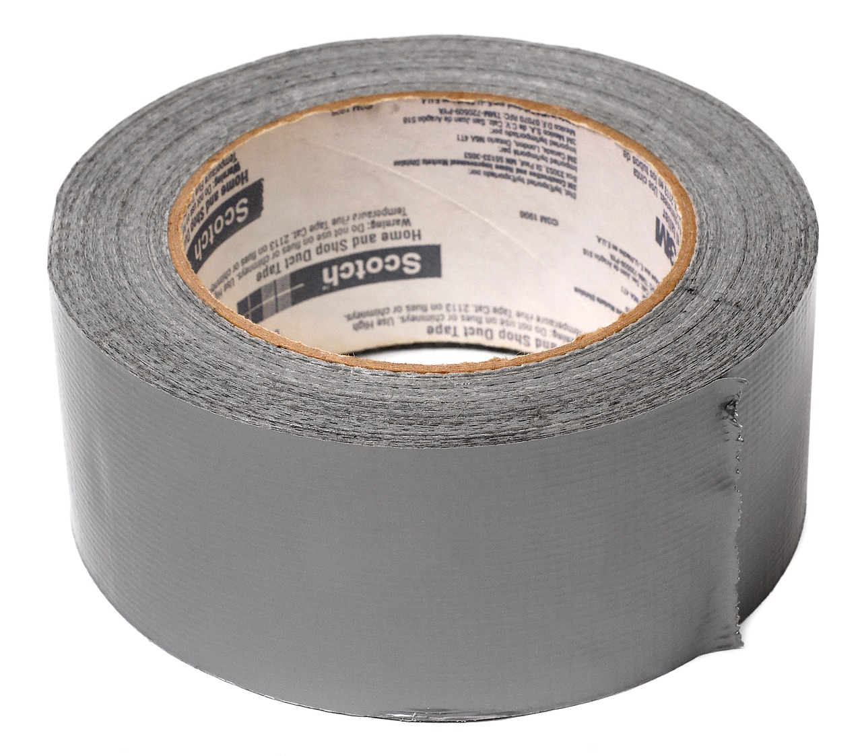

FROM VLOOKUP() Duct Tape to JOIN Blowtorch

Slide 103

Key-lookup
Primary key: Unique, unchanging identifier
Foreign key: References the primary key of another table

Slide 104

Ever been asked for your ID number?
That’s your primary key!

Slide 105
One-to-one relationship

Slide 106
One-to-many relationship

Slide 107
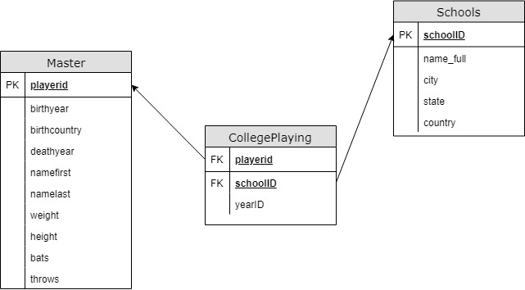
Introducing Schemas

Slide 108
INNER JOIN
Returns records with matching values in both Table A and Table B
TABLE A
TABLE B

Slide 109
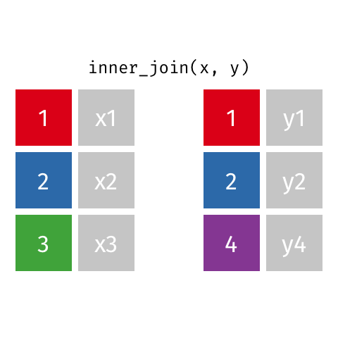
Visualizing an INNER JOIN
https://github.com/gadenbuie/tidyexplain#mutating-joins

Slide 110
Demo: inner-join-demo.sql

Slide 111
Drills
For the Master and HallOfFame tables:
Return a list of unique first and last names for all individuals in HallOfFame
Return first and last names along with the year, votes needed and votes received for all successful HoF inductees
Return the birth year of the oldest individual inducted for each year of HoF inductions. How “old” was each player at induction?

Slide 112
Drills
For the Master and HallOfFame tables:
Return a list of unique first and last names for all individuals in HallOfFame
Return first and last names along with the year, votes needed and votes received for all successful HoF inductees
Return the birth year of the oldest individual inducted for each year of HoF inductions. How “old” was each player at induction?
Solutions: inner-join-drills.sql

Slide 113
LEFT OUTER JOIN
Returns all records from Table A and matching records from Table B. NULL if no match.
TABLE A
TABLE B

Slide 114

Visualizing a LEFT OUTER JOIN
https://github.com/gadenbuie/tidyexplain#mutating-joins

Slide 115
Demo: left-outer-join-demo.sql

Slide 116
Drills
Find the maximum annual salary paid to anyone included in Master, sorted descending by salary.
Keeping the names of all schools listed in Schools, find the first name, last name and years played for all schools (Check CollegePlaying).

Slide 117
Drills
Find the maximum annual salary paid to anyone included in Master, sorted descending by salary.
Keeping the names of all schools listed in Schools, find the first name, last name and years played for all schools (Check CollegePlaying).
Solutions: left-outer-join-drills.sql

Slide 118
From “That’s hard in Excel!” to “That’s easy in SQL!”

Slide 119
Demo: hard-in-excel-easy-in-sql.xlsx

Slide 120
Demo: hard-in-excel-easy-in-sql.sql

Slide 121
CASE expressions
CASE
WHEN condition THEN result-expression
WHEN condition THEN result-expression ...
ELSE result-expression
END AS alias

Slide 122
Subqueries as condition: WHERE
SELECT fields
FROM table
WHERE operator
-- Subquery
(SELECT fields
FROM table);

Slide 123
Common table expressions (CTEs): Expressions acting like tables
WITH
expression_name_1 AS
(CTE query definition 1)
SELECT expression_A, expression_B, ...
FROM expression_name_1

Slide 124
Drills
Using the Teams table:
In 2016, what teams had more wins than the Chicago Cubs (teamID = ‘CHN’?)
Create a field Century which marks records in the 19th Century as 19, 20th as 20 and 21st as 21.
Find the average season minimum attendance since 1990.

Slide 125
Drills
Find the maximum annual salary paid to anyone included in Master, sorted descending by salary.
Keeping the names of all schools listed in Schools, find the first name, last name and years played for all schools (Check CollegePlaying).
Solutions: hard-in-excel-easy-in-sql.sql

Slide 126
SQL: The Prequel

Slide 127

Learning SQL, 2nd Edition
by Alan Beaulieu

Slide 128

SQL Cookbook
By Anthony Molinaro

Slide 129
Find me
georgejmount.com
@gjmount
github.com/summerofgeorge

Slide 130
Thank you

